Slide 1


Notes:
Trippus is the registration partner to Live Expo. We manage tickets, information, and related services for visitors, as well as exhibitor services. A few days before the trade fair, we will send you an SMS with a link where you can access your ticket, the program, and practical information. It is a web link that does not need to be downloaded and can be opened directly.

Slide 2
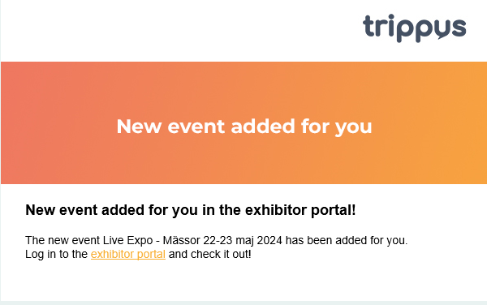
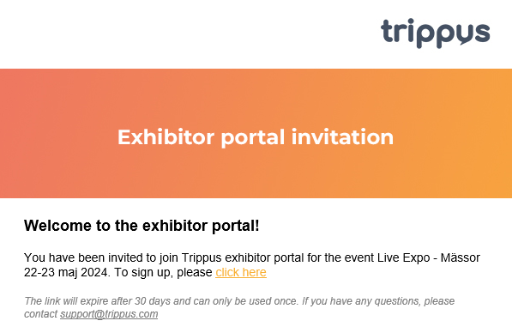
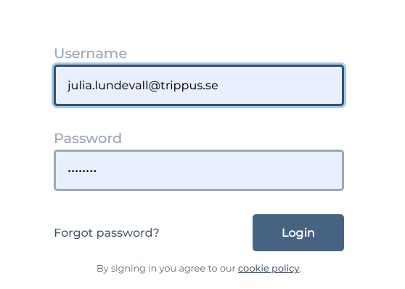
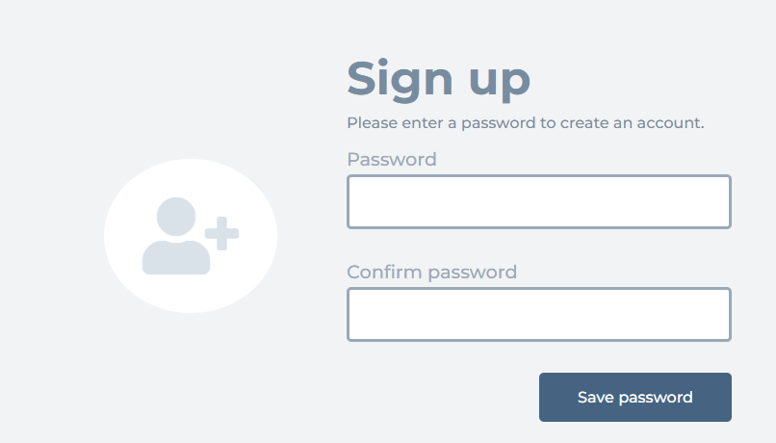
Existing users
New users
Notes:
All contact persons for the stands should have received / will receive an email from Trippus with instructions. Only those of you who received the email with access to the portal need to log in this way – not everyone working in the booth. It is important that the person responsible for the administrative matters related to the exhibition is the one who receives the login details.
If you have previously exhibited with Live Expo or at another event that uses Trippus, you will have received an email informing you that a new event has been added to your account in the Exhibitor Portal. Simply click the link in the email to log in. If you do not remember your password, you can request a new one from the login page.
For new exhibitors or companies with a new contact person, the email will state “Welcome to the Exhibitor Portal” – please make sure to follow the link to create your account. This link is valid for 30 days. If you experience any issues accessing the portal, you are welcome to contact our support at support@trippus.com.

Slide 3
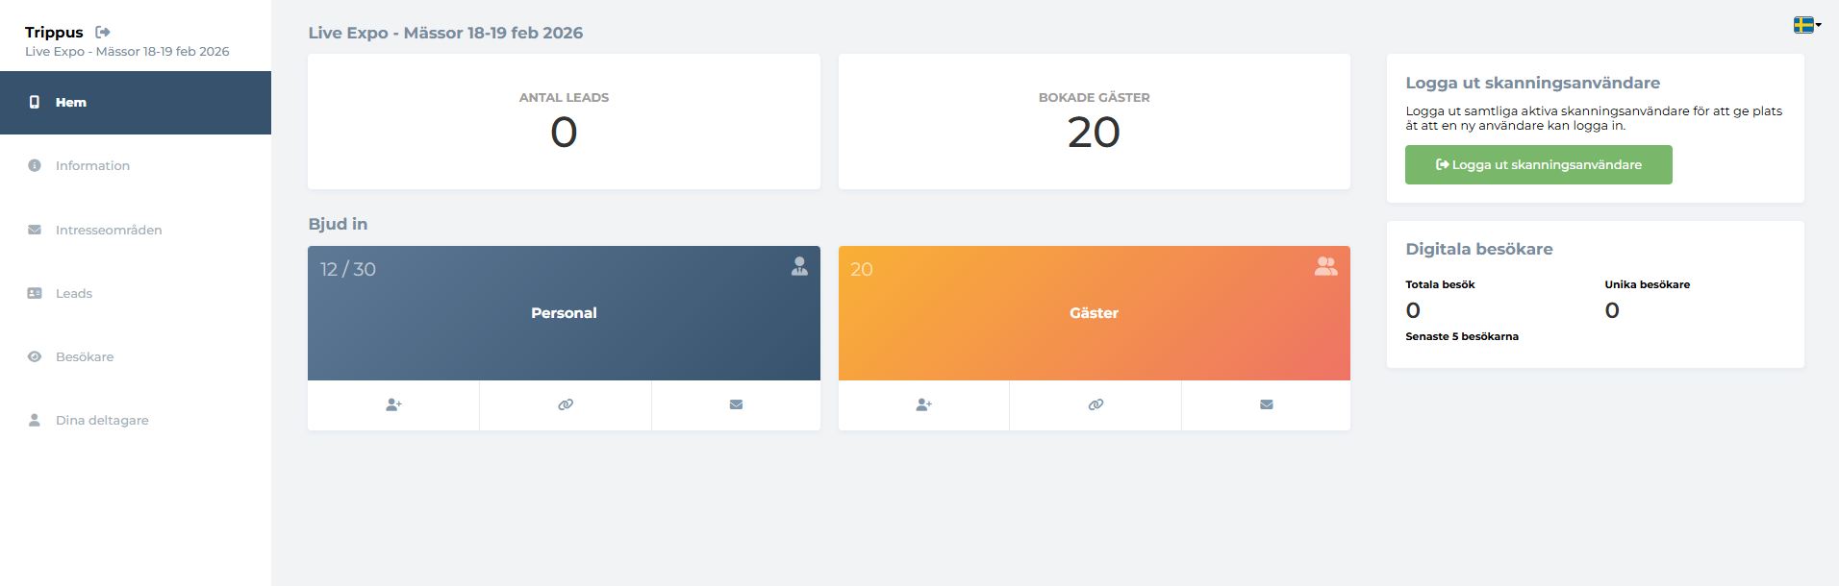
Notes:
Once you have logged in, you will be taken to this view.
Here you can add your booth staff under “Staff” in order to access the forms and fill in the required information. Click on any of the underlined icons. It is important to register your booth staff in advance to avoid complications on the event days – being prepared helps you avoid queues. Please also add yourselves in the form if you will be present at the exhibition.
You can also invite guests or add them manually under “Guests” (recommended, as it allows for personal invitations). Click on any of the underlined icons. Registered guests can be found under “Your Participants” in the left-hand menu.
New for this year!
Lead Scanning is included for one user in all booths. Lead Scanning makes it easy to collect leads during the exhibition. Booth staff who are registered via your Exhibitor Portal under “Staff” will have access to the Lead Scanning function directly via their personal SMS link – I will show what this looks like shortly.
If you want all booth staff to be able to scan leads, you can purchase the Plus Package by emailing Live Expo or by visiting the Trippus Lead Scan desk at the exhibition for an upgrade. Those of you who have one scanning user will be able to control which device is logged in via the green button “Log out scanning user”.
All questions regarding Lead Scanning as a service should be directed to Trippus, who will be located opposite the cloakroom / near the upper part of the escalator. Questions regarding pricing and packages should be directed to Live Expo samhalle@liveexpo.se

Slide 4
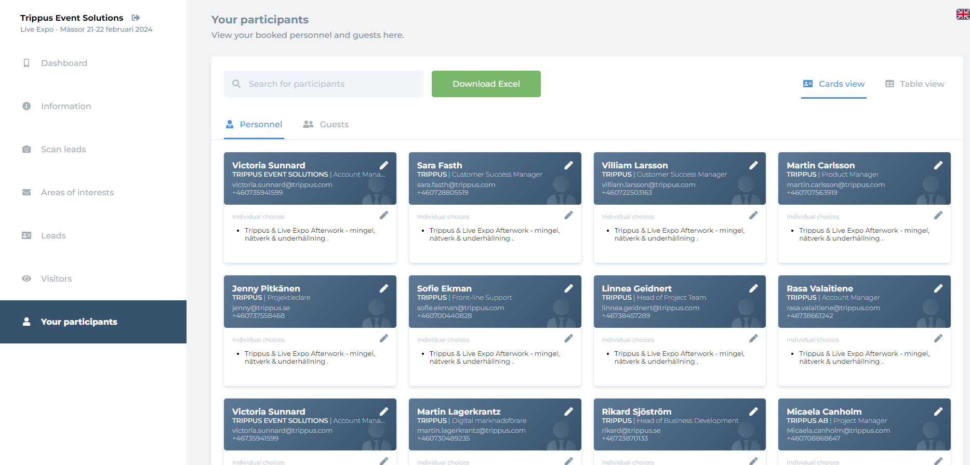
Notes:
In the Participants view, you can get an overview and edit details and selections for your staff and guests, for example if someone wants to add a networking event or update their phone number.

Slide 5
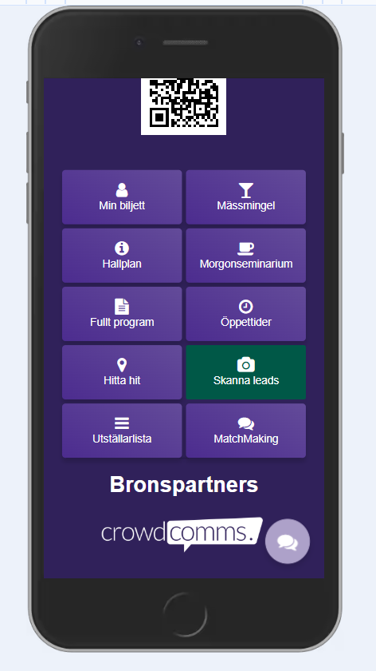
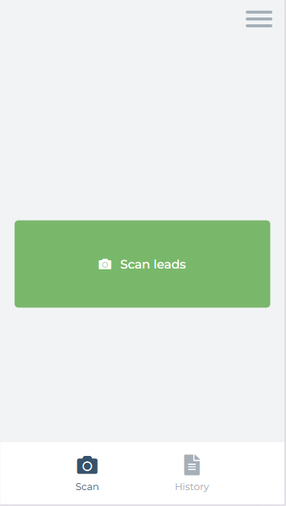
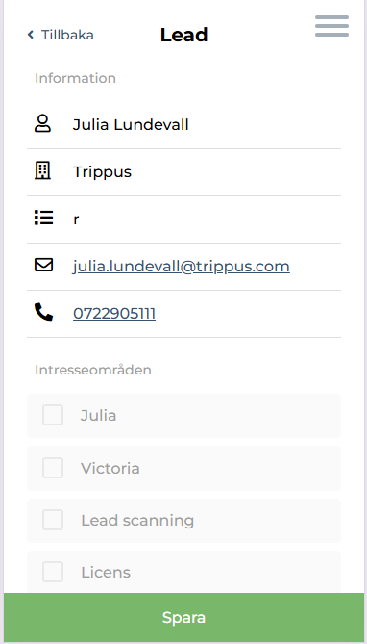
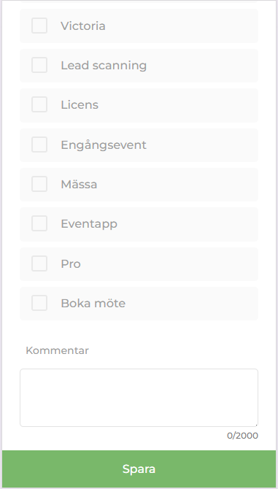
Scan Leads
Notes:
Trippus Lead scanning that I mentioned, is not something you need to download. It is a web-based service that you access directly through your browser via the link in the SMS sent out before the exhibition. If you click on Lead Scan in the app, you will see this view – your booth staff can also access the lead scanning function via their own event app, if this is included. They will receive this via SMS before the exhibition. No login is required.
Click on “Scan leads” and then the green button, and allow access to the mobile camera. Point the camera at the QR code on the visitor’s name badge. Once the scan is completed, you can select interest areas for that lead or add a comment. This helps with tagging and structuring your leads. Don’t forget to save!
As a logged-in user, you can create as many different interest areas as you like under the “Interest Areas” tab. You can do this in advance or during the exhibition.
All of the company’s leads will then be collected under the “Leads” tab in the portal. From there, you can export them, for example to Excel.
For more information – vvisit www.trippus.net/Lead-Scan

